Slide 1
MLA Formatting
Mary Johnson
Ms. Reisdorf
English 9B
1/23/15
Johnson 1
LT: I can format a document and cite evidence using MLA guidelines.

Slide 2
When & Why do I need to use MLA
When: Typically used in the liberal arts and
humanities (English, Social Studies, etc.)
Why: Having a common formatting system
makes it easier for readers to read and
navigate through your work.

Slide 3
MLA Checklist: (write this down)
⏩ Header
⏩ First and Last Name
⏩ Teacher’s Name
⏩ Name of Class
⏩ Date
⏩ Page #s W/ Last Name
⏩ Correct Font
⏩ Size 12
⏩ Times New Roman/Arial
⏩ Double Space & One Inch Margins
Mary Johnson
Ms. Reisdorf
English 9B
1/23/15
Reisdorf 1

Slide 4
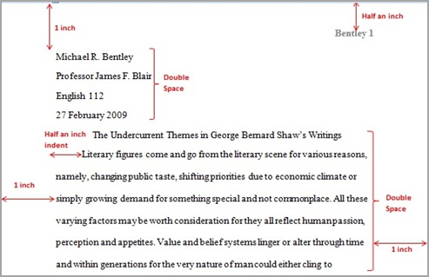
Example:
How to format document in Google Docs

Slide 5
Parenthetical Citations
When using textual evidence, you must cite it with an in-text parenthetical citation.
Requirements:
Parenthesis
Page Number
Period on OUTSIDE of citation.
The author claims that dogs have been studied for a long time, “For decades, scientists have been studying ‘social cognition’ in dogs” (1).

